Slide 1

Past Paper Scaffold
The aim of this PowerPoint is to assist you in completing a past paper question.
It is split into 3 sections.
Section 1: here’s the question – off you go! Try the question on your own first. Maybe you’ll be able to do it without any help!
Section 2: Need a few hints? If you can’t do the question on your own, watch this slide. Listen to me “thinking out loud” to give you some hints and ideas.
Section 3: Totally confused? Listen to me talking through the whole question in detail.
At the end of the PowerPoint you’ll find the mark scheme to check your work.
Topic: Integration

Slide 2
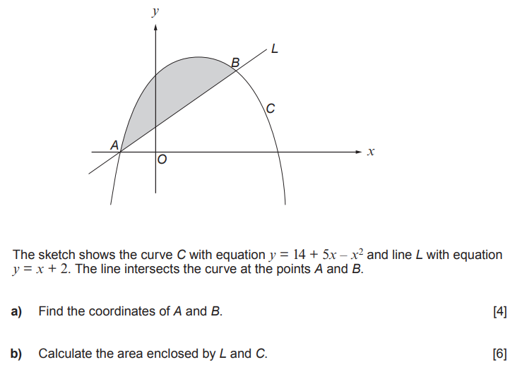

Option 1: Here’s the question – off you go!
You’ve got this!

Slide 3

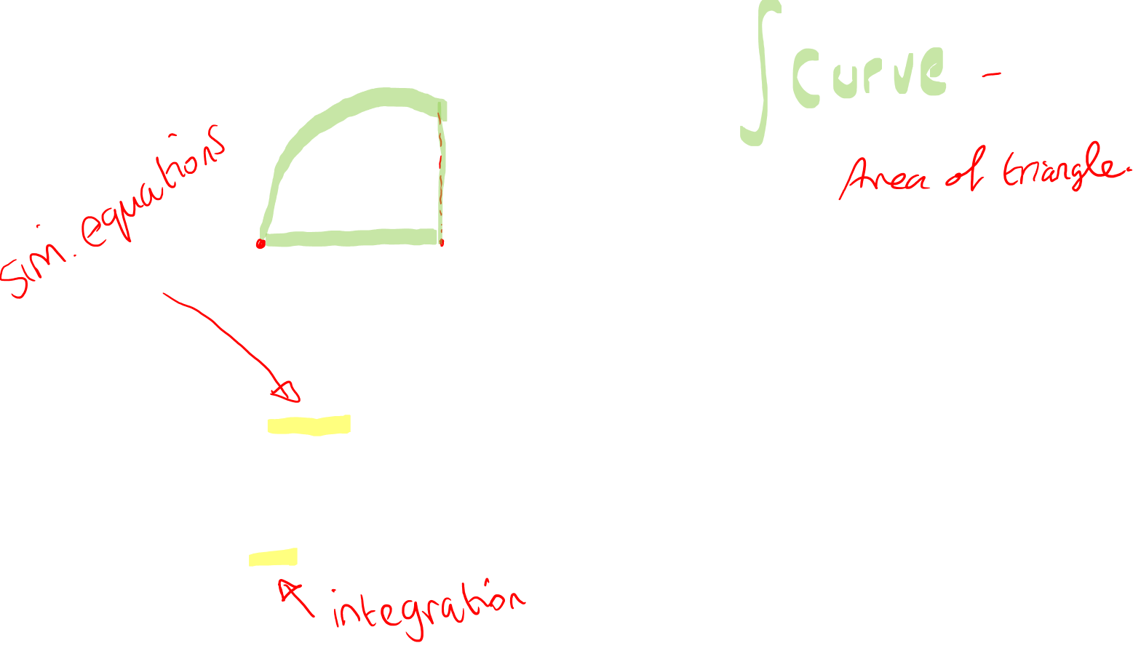
Option 2: Need a few hints to get started?
Want some hints?

Slide 4

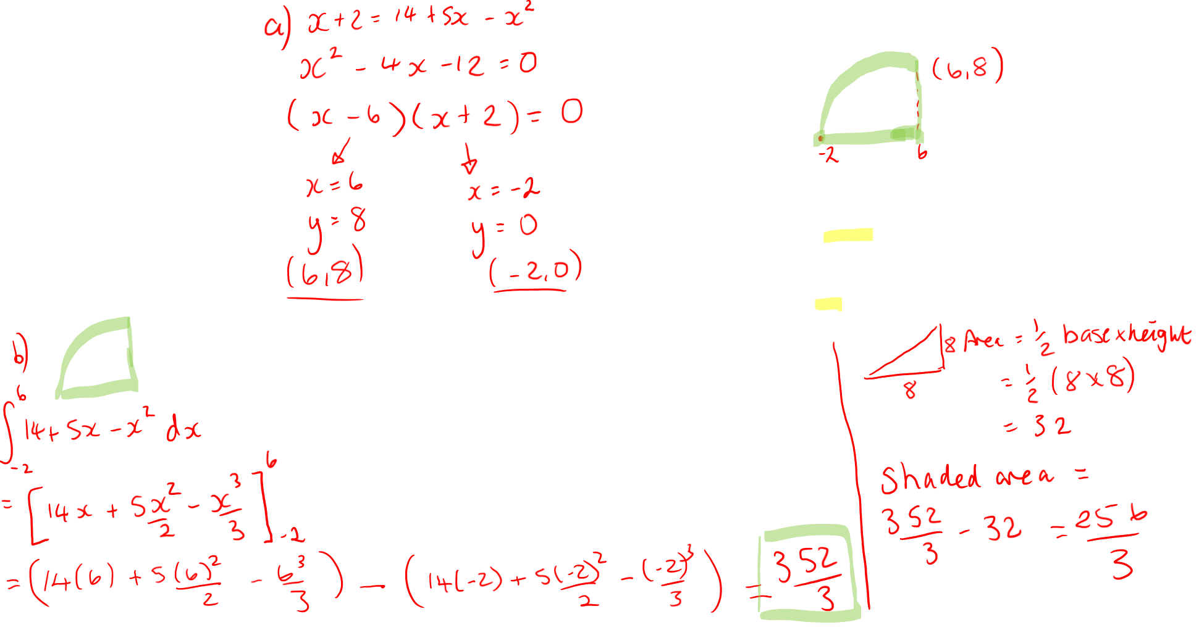
Option 3: Totally confused? I’ll show you
I’m stuck!

Slide 5
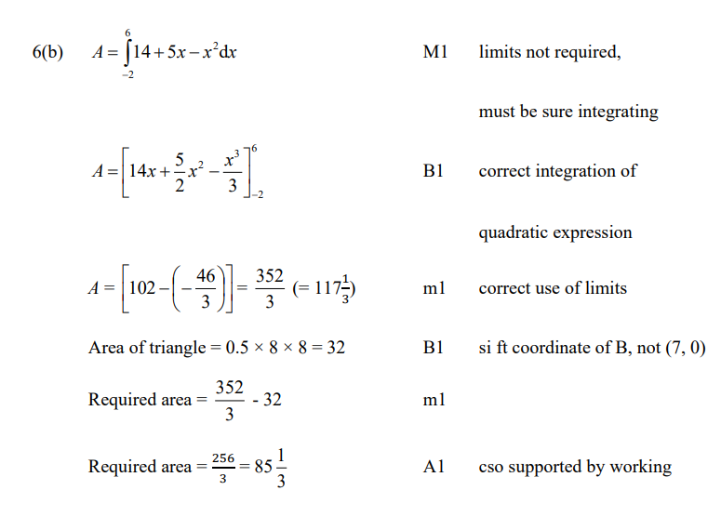
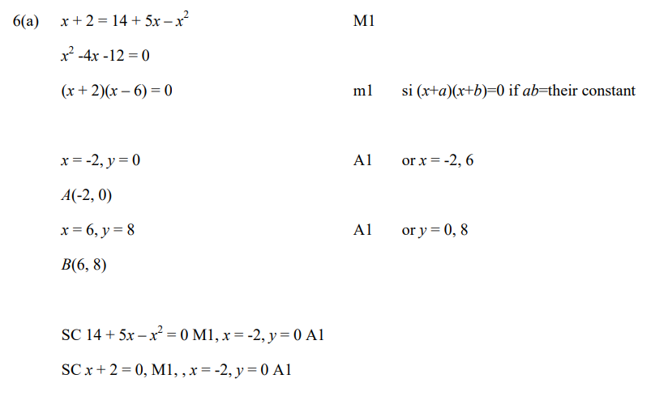
The Mark Scheme

